Slide 1
Demonstrations
The Integumentary System
Skylar, Ansley, and Rayne

Slide 2
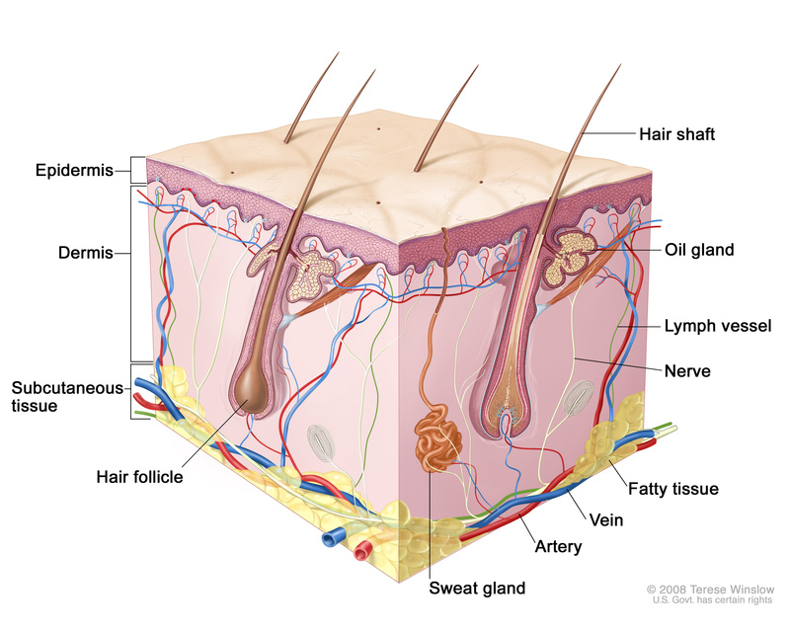
Try these activities to find out what really happens in your Integumentary System!

Slide 3
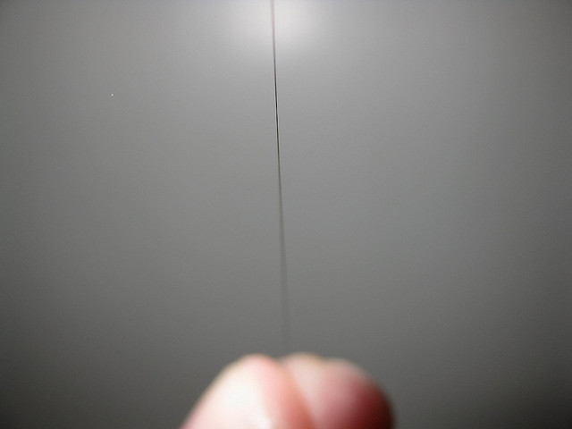
The Strength of Hair
Hair is amazingly strong, with a tensile (pulling) strength greater than steel wire of the same thickness.
Pull on a long piece of scalp hair.
Compare its strength to cotton thread, which is about 100 times thicker?

Slide 4
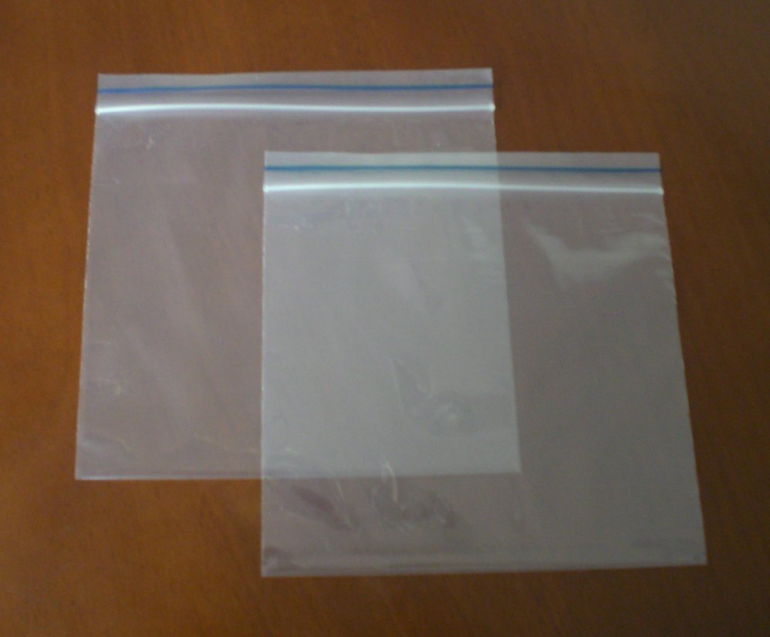
Sweat Surprise!
Put a clear plastic bag over your and for a few minutes, tied loosely at your wrist.
Watch as tiny water drops form inside the bag as sweat evaporates from your skin and condenses on the plastic.
Why is this? Your skin constantly releases a small amount of sweat, even if you stay still.

Slide 5
Thickness of Your Skin
Gently pinch a fold of your skin on the back of your hand between your thumb and your forefinger.
Your skin is about half of this thickness.
Try this on various body areas.
Where is your skin the thickest?

